Slide 1

Infographics:
Visualizing Information
Hannah Rainey
http://go.ncsu.edu/infographics

Slide 2
Workshop Overview
What is an infographic
When to use an infographic
Examples of infographics
Elements of design
Infographic Resources
Activity using Piktochart
http://go.ncsu.edu/infographics

Slide 3
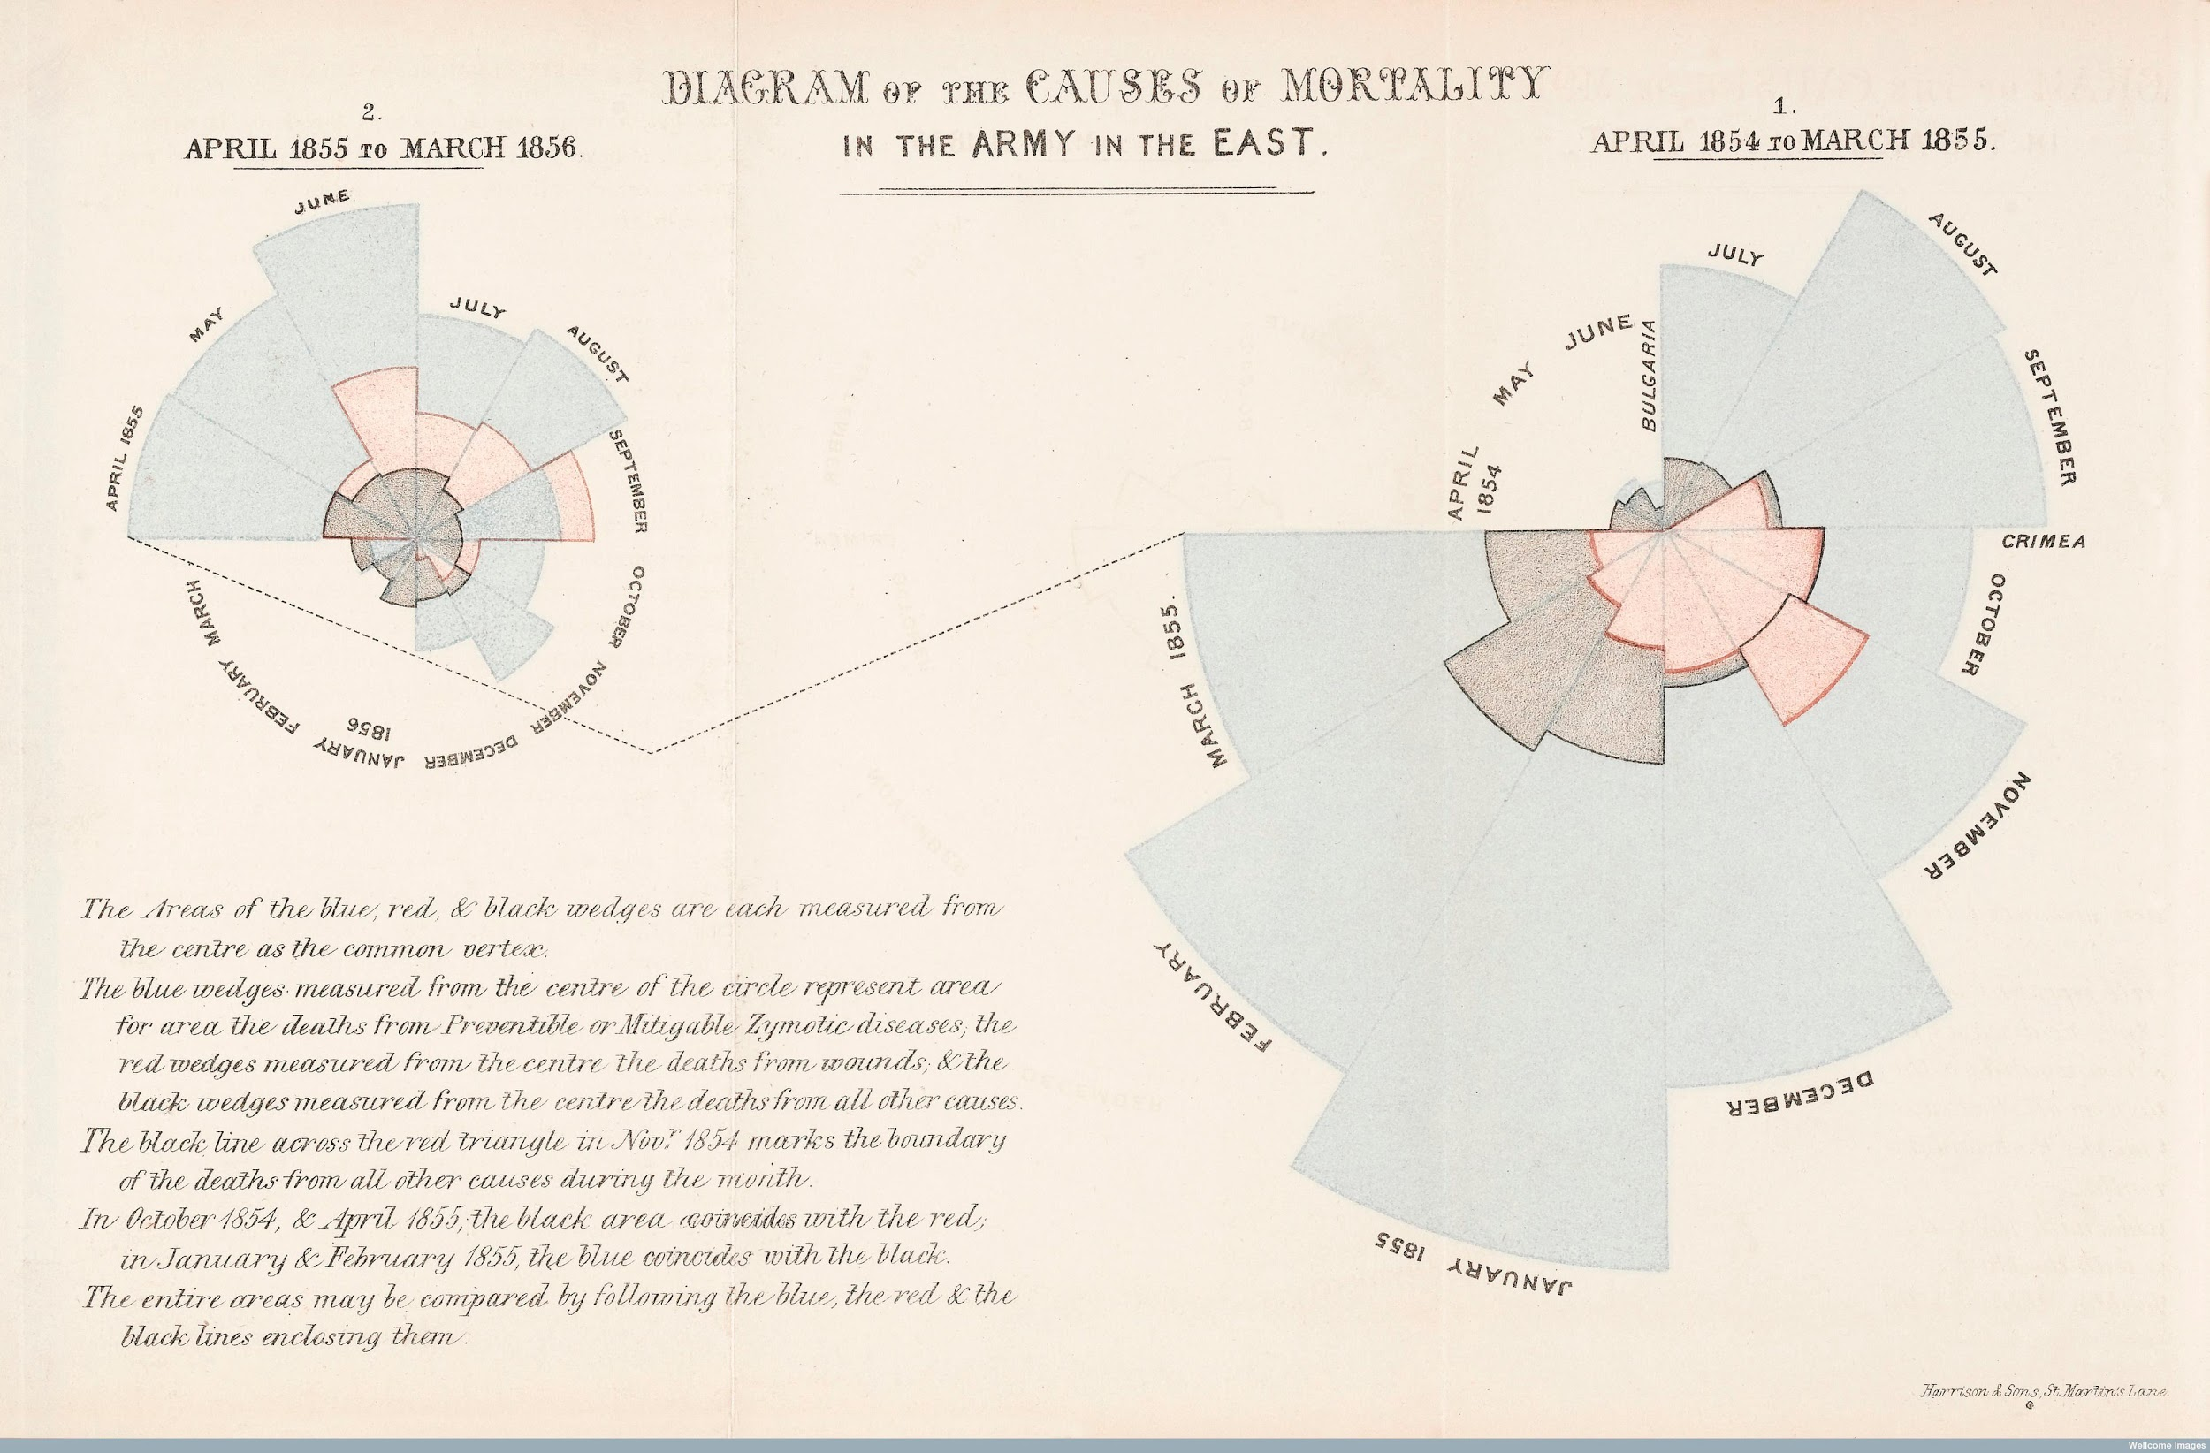
Notes:
Infographics and data visualization have been around for a long time. This graphic was made by Florence Nightingale in 1858 to show the

Slide 4
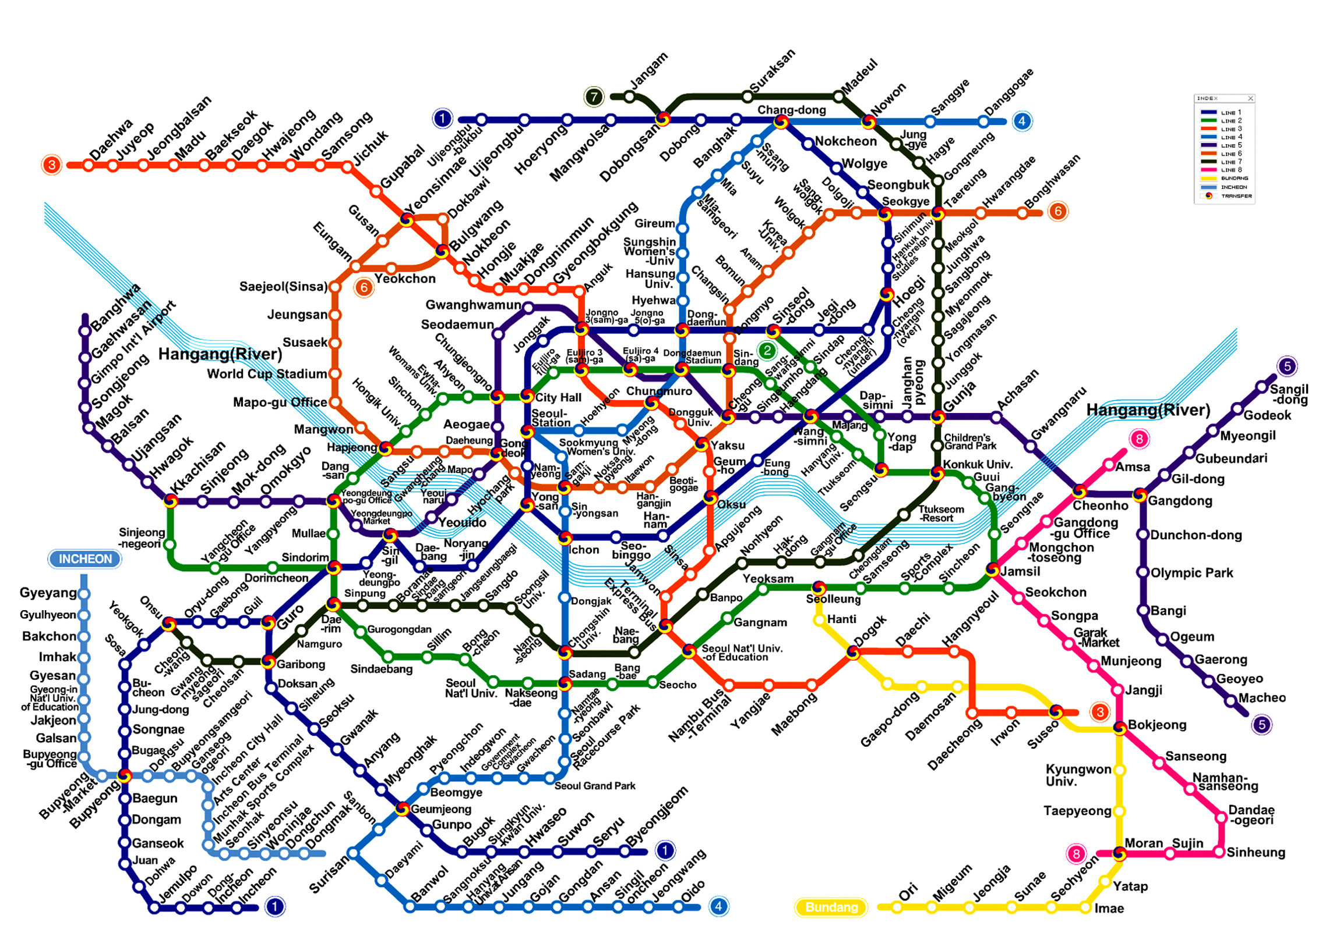
Notes:
Subway maps are a common example of commonplace, functional infographics.

Slide 5

What is an infographic?
http://go.ncsu.edu/infographics

Slide 6

Infographics support an argument.
Infographics raise awareness and educate.
Infographics tell a story.
Infographics represent information through graphics, images, and minimal text.

Slide 7
Are infographics and data visualization the same?
http://go.ncsu.edu/infographics
Notes:
Ask and discuss

Slide 8
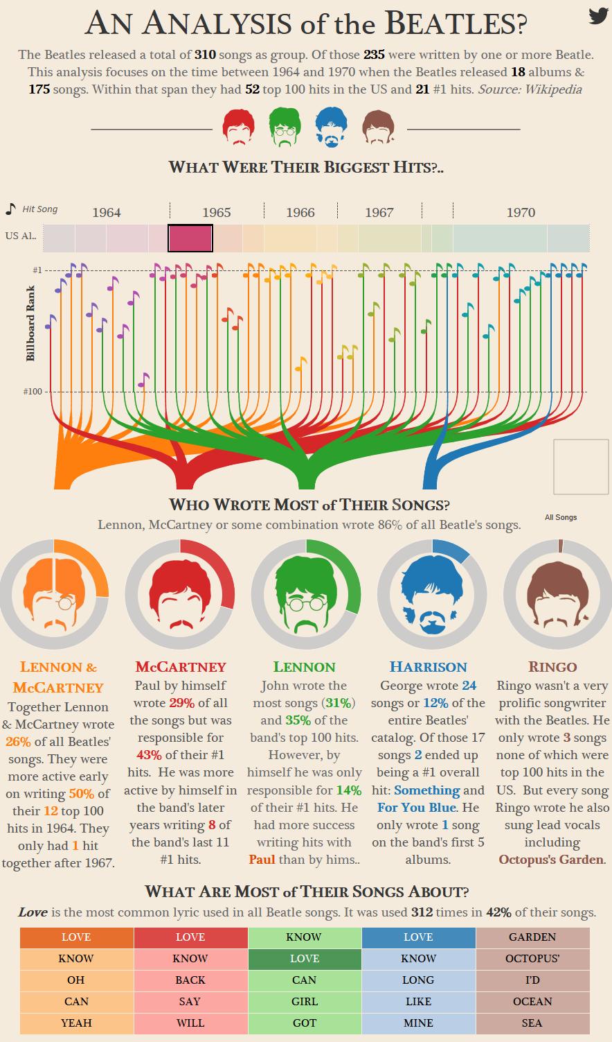
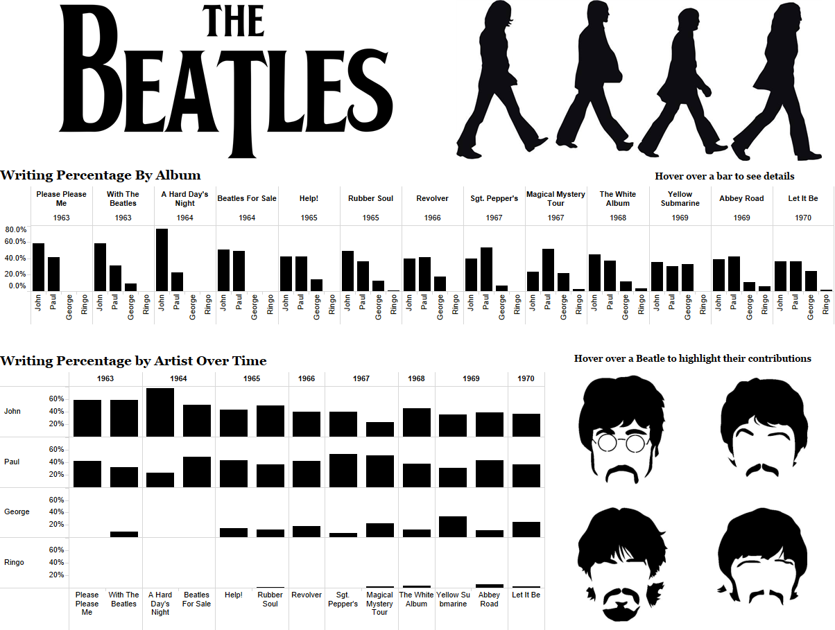
Infographic or Data Visualization?
Notes:
Sources:
http://duelingdata.blogspot.com/2016/01/the-beatles.html
https://public.tableau.com/views/BeatlesWritingContributionsbyAlbum/TheBeatles?:embed=y&:loadOrderID=0&:display_count=yes&:showTabs=y

Slide 9
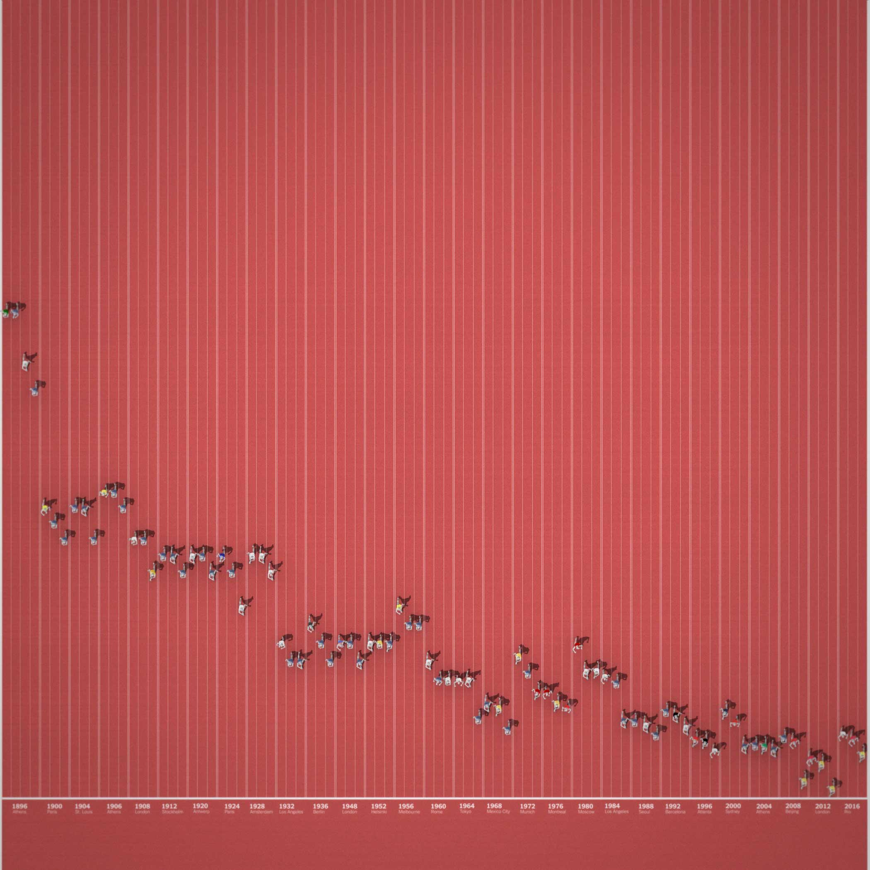
Infographic or Data Visualization?
Notes:
http://www.nytimes.com/interactive/2016/08/15/sports/olympics/usain-bolt-and-120-years-of-sprinting-history.html?_r=0
The entire article includes graphics that support the story - Usain Bolt is FAST

Slide 10
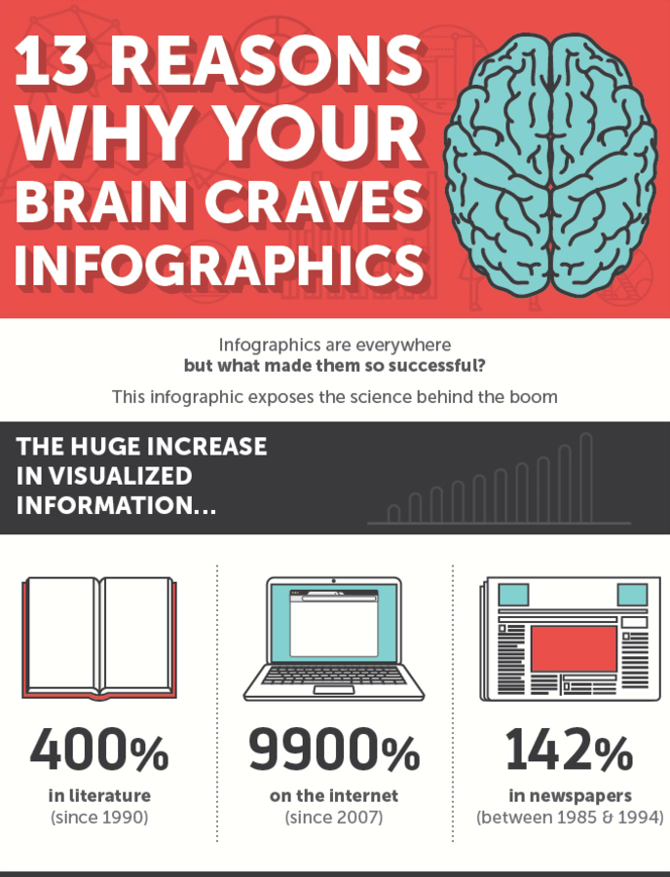
Why use infographics?
Notes:
Discuss: http://neomam.com/infographics/the-reasons-why-your-brain-craves-infographics

Slide 11
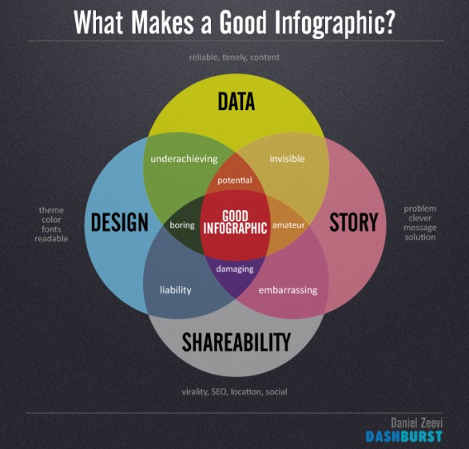
Notes:
Source: http://visual.ly/what-makes-good-infographic?utm_source=visually_embed

Slide 12
Misleading Infographics

Slide 13

Notes:
Issues with scale and representation of data
Source: https://www.theguardian.com/news/datablog/gallery/2013/aug/01/16-useless-infographics

Slide 14
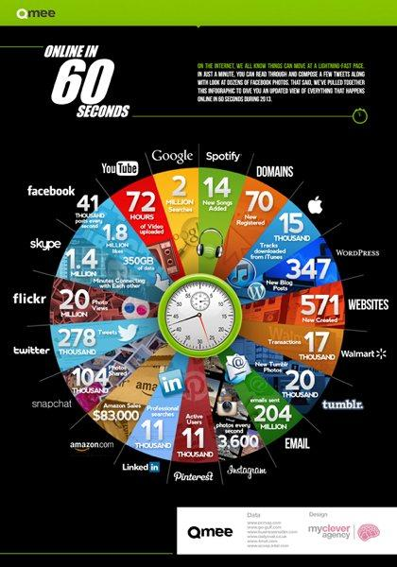
Notes:
Why do all of these things have an equal slice of the pie?
Sources: https://www.theguardian.com/news/datablog/gallery/2013/aug/01/16-useless-infographics

Slide 15
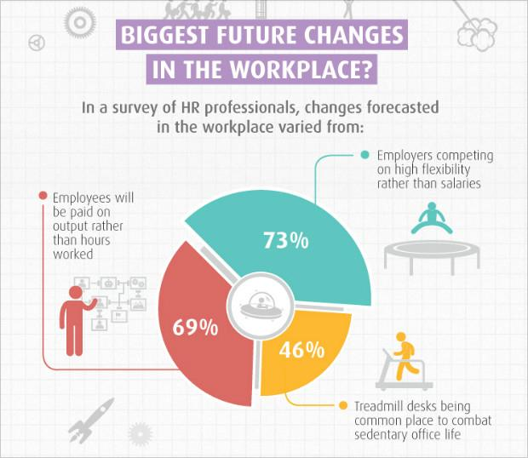
Notes:
The numbers don’t add up.
Source: http://blog.visme.co/bad-infographics/

Slide 16
Infographic Examples

Slide 17
Short Activity
On your own, or in a small group, look at one of the examples below. Think about and discuss what you like/dislike about this infographic.
Examples:
The Facts Behind Food Prices
Slingshot Fund Map
The Almighty Dollar
Left Right
What are We Eating?

Slide 18
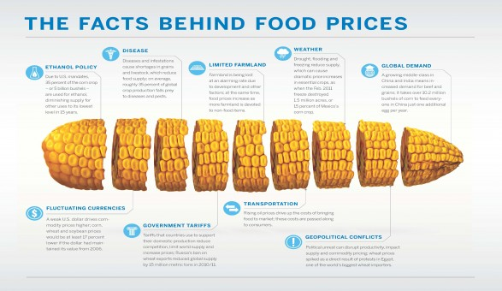
The Facts Behind Food Prices

Slide 19
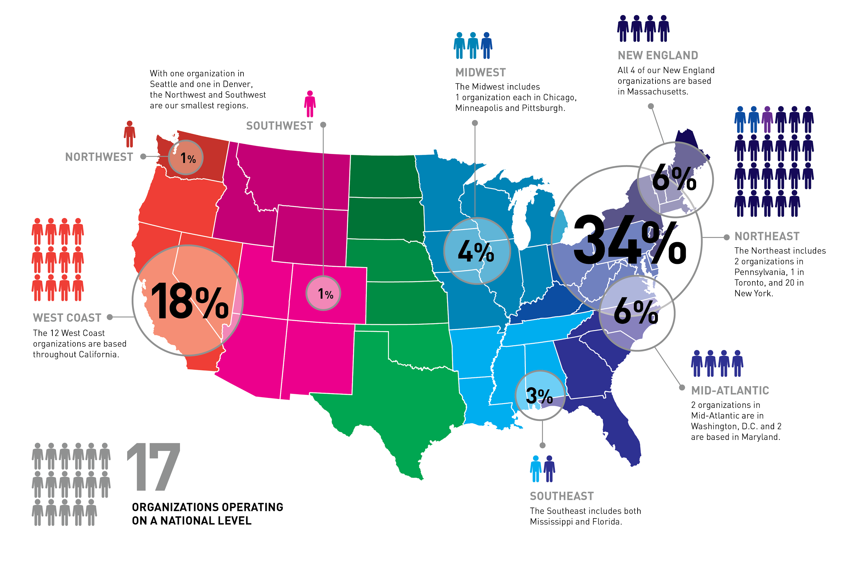
Slingshot Fund Map

Slide 20
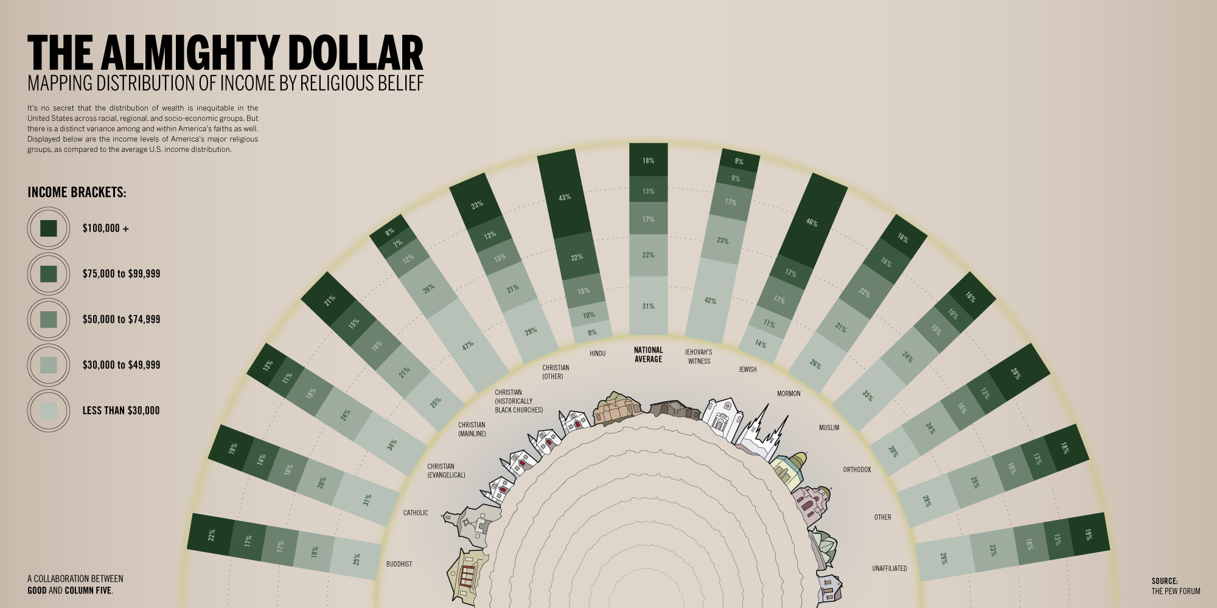
The Almighty Dollar
Notes:
Source: http://www.columnfivemedia.com/9-infographic-design-examples-that-will-leave-you-inspired

Slide 21
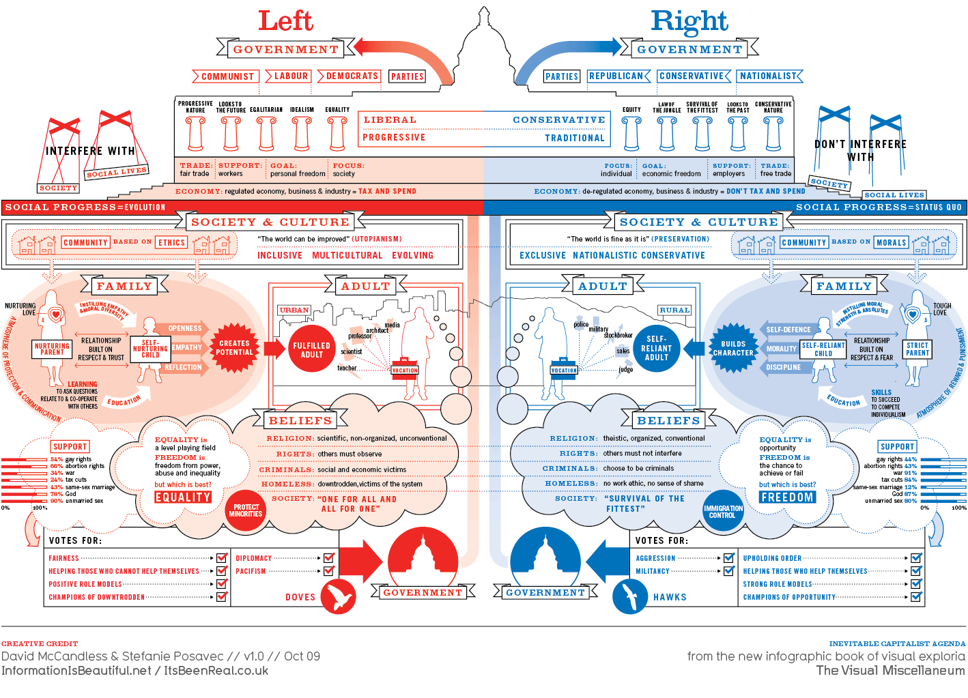
Left Right

Slide 22
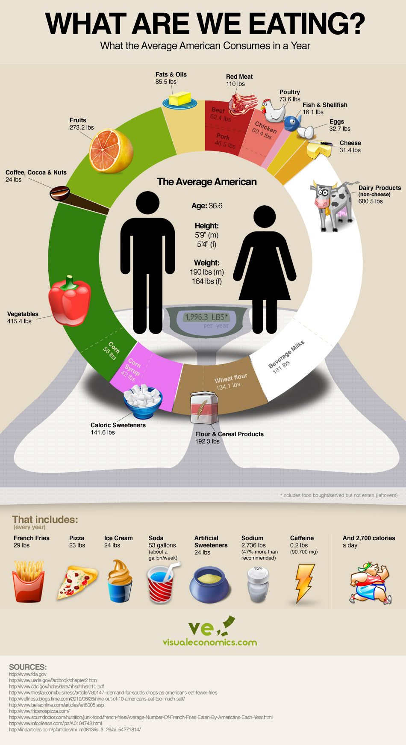
What are We Eating?

Slide 23
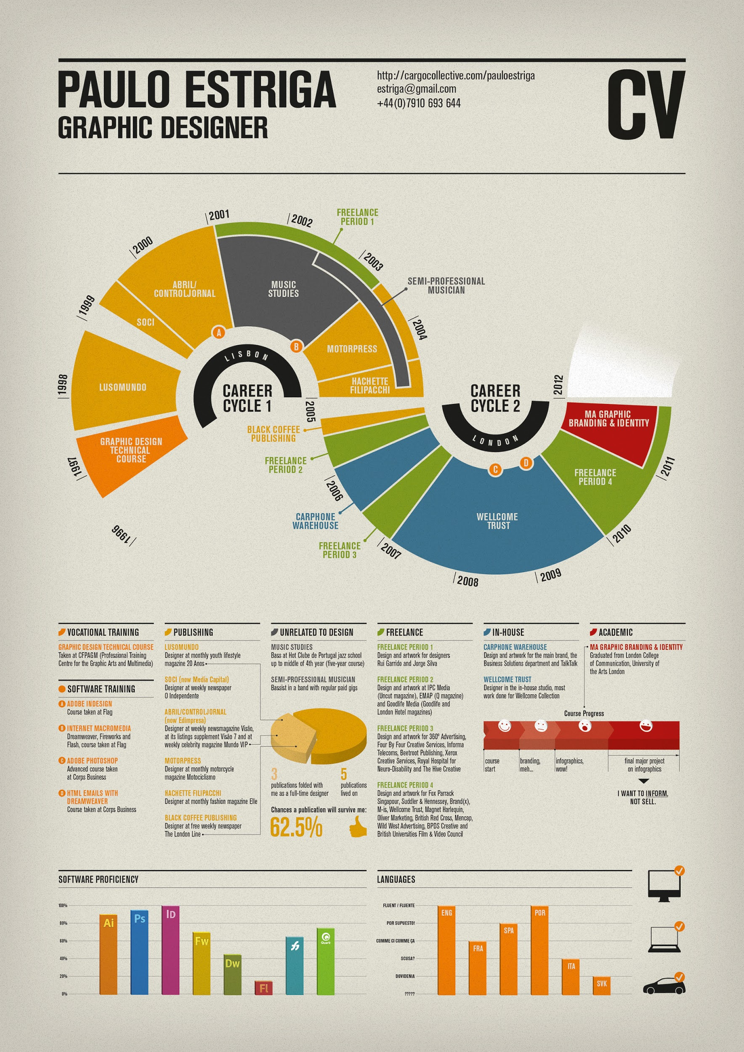

Slide 24
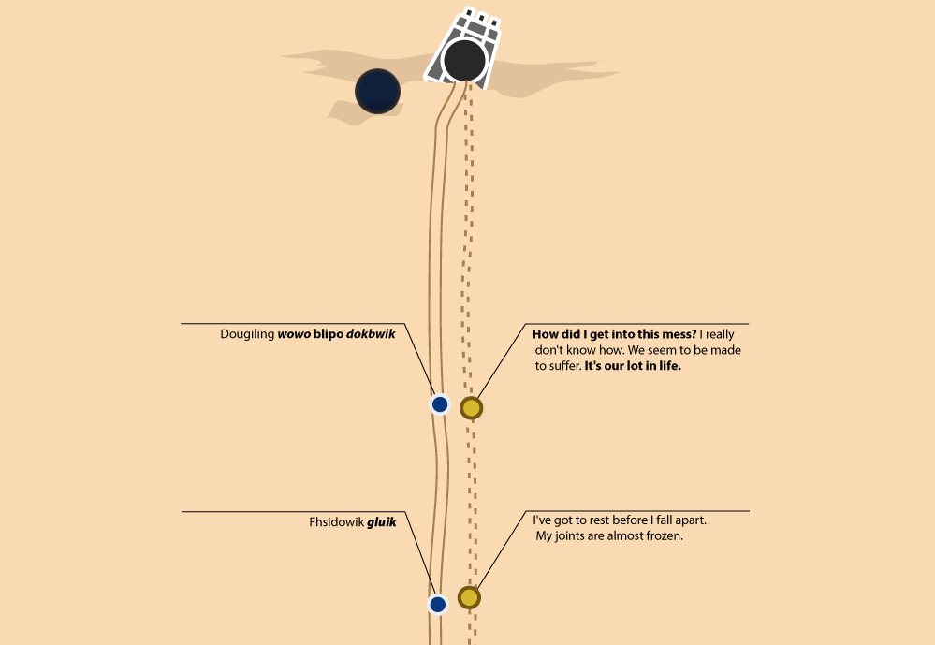
Notes:
http://swanh.net/

Slide 25



Design Process
Decide the story you want to tell
Collect data
Sketch or storyboard your ideas
Find images and icons
Create your infographic

Slide 26
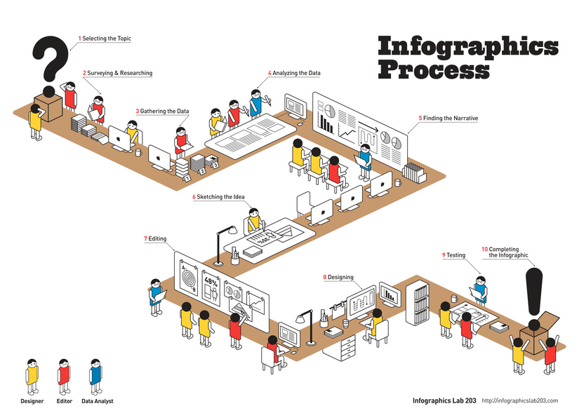

Slide 27
Design Guidelines
Keep it visually simple
Be consistent with visual style
Limit yourself to 6 or fewer colors
Use legible typography and font
Consider the final format (print, on screen, mobile, etc.)
Use high definition graphics (png, svg)

Slide 28
Color
Type
S P A C E

Slide 29
Resources

Slide 30
Software
Microsoft Powerpoint -
Online tutorials, templates, and documentation
Adobe Illustrator & inDesign -
Steep learning curve. Full control over design
InkScape -
Free & open source, similar to Illustrator https://inkscape.org
Software tools afford greater author control, but require more skill

Slide 31
Online
Piktochart -
Upload data and generate charts and maps
Canva -
Great guidelines for beginners
Easel.ly -
Simpler options, easy to use
Online tools are easy to use, but offer limited control over design.
Notes:
These are a few popular options for online Infographic generators. They are easy to use with a lot of built in design features. However, you are limited in the free versions by the amount of space, variety of file types for download, and sharing features. These options also allow for interactive infographics.

Slide 32
Other useful tools
The Noun Project: https://thenounproject.com/
Colorbrewer 2.0: http://colorbrewer2.org/

Slide 33
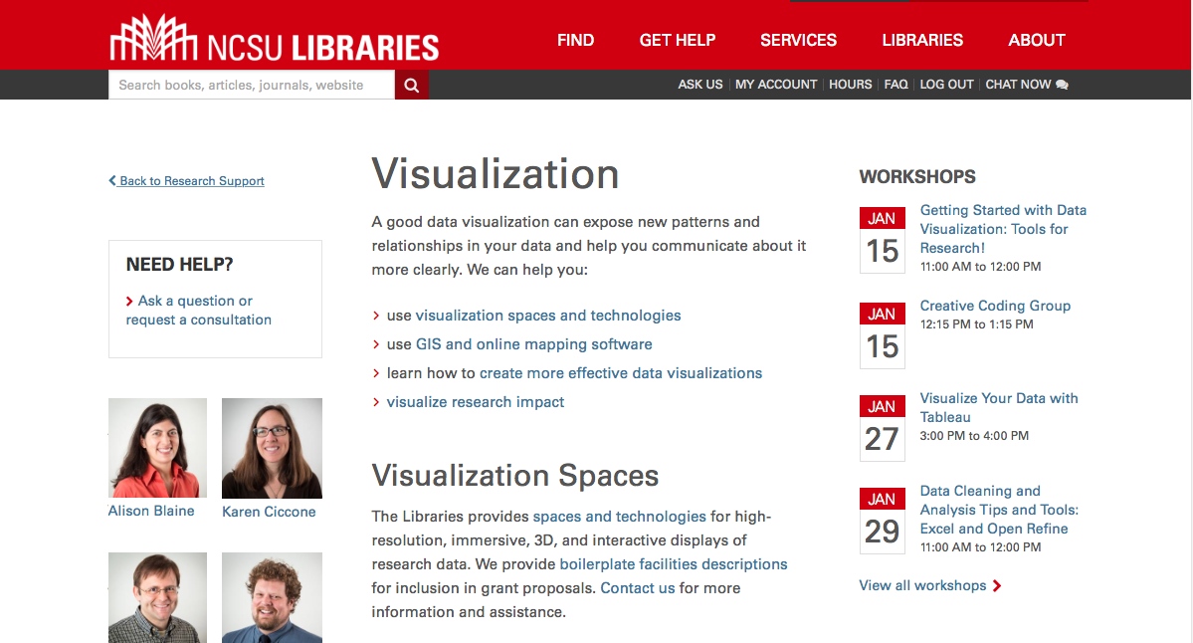
Data Visualization Services lib.ncsu.edu/do/visualization
Notes:
Alison
CHANGE THIS LINK to Visualization services

Slide 34
Activity:
Create an Infographic with Piktochart

Slide 35
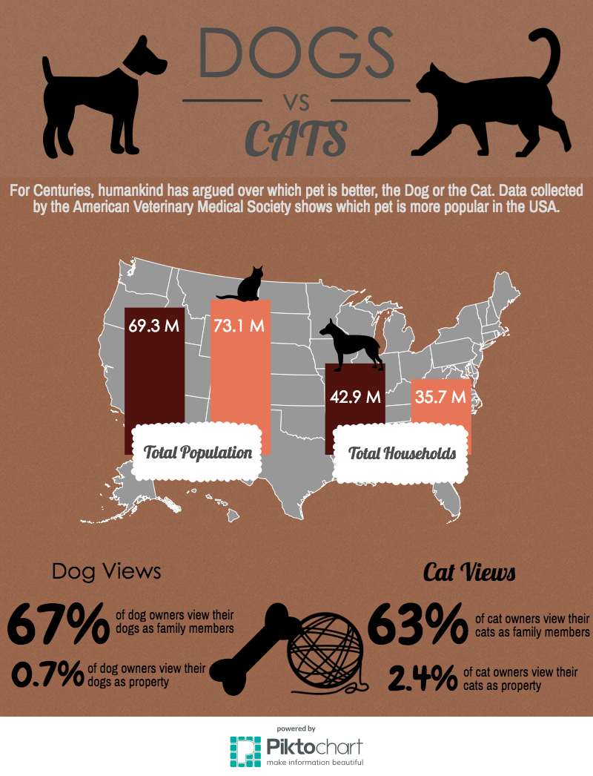
Follow along to make this infographic, or explore on your own.

Slide 36
If you like Piktochart, here are some more resources to help.
If you didn’t like it, try one of these.

Slide 37
Find and share an infographic
http://www.dailyinfographic.com/ http://www.coolinfographics.com/
Notes:
Use the apple TVs to share infographics

Slide 38
Please take a moment to fill out an evaluation:
go.ncsu.edu/libeval
Thank you!
hlrainey@ncsu.edu
Notes:
Use the apple TVs to share infographics

Slide 39





Image Credits
Icons from thenounproject.com:

